Slide 1
Programma Erasmus+
KA2- Coopération en matière d’innovation et d’échanges de bonnes pratiques
Durée: 3 ans (2016-2019)
Titre du projet
Unissons nos cœurs sans frontières

Slide 2
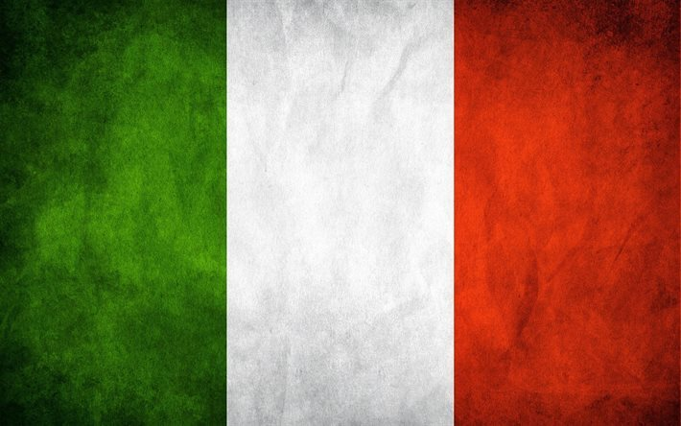
ITALIAN FESTIVITIES

Slide 3
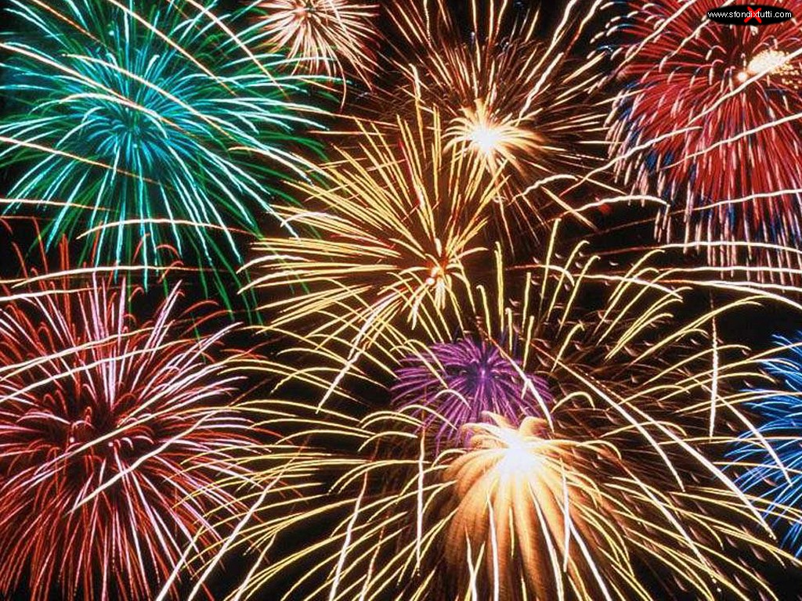
NEW YEAR’S day

Slide 4
New Year's Eve (also known as Old Year's Day or Saint Sylvester's Day in many countries), the last day of the year, is on 31st December which is the seventh day of Christmastide. In many countries, New Year's Eve is celebrated at evening social gatherings, where many people dance, eat, drink alcoholic beverages, and watch or light fireworks to mark the new year.
In Italy, New Year's Eve (Vigilia di Capodanno or Notte di San Silvestro) is celebrated by the observation of traditional rituals, such as wearing red underwear. An ancient tradition in southern regions which is rarely followed today was disposing of old or unused items by dropping them from the window.
Dinner is traditionally eaten with relatives and friends. It often includes zampone or cotechino (a meal made with pig's trotters or entrails), and lentils. At 20:30, the President reads a television message of greetings to Italians.
At midnight, fireworks are displayed all across the country. Rarely followed today is the tradition that consist in eating lentil stew when bell tolls midnight, one spoonful per bell. This is supposed to bring good fortune; the round lentils represent coins.

Slide 5
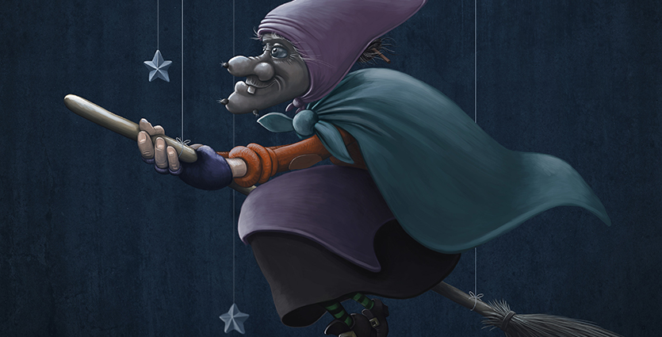
06 janvier : Befana
6th JANUARY EPIPHANY

Slide 6
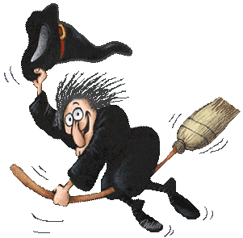
In Italy, La Befana is loved as much as Santa Claus. She is usually portrayed as an old woman who wears a black shawl and rides a broomstick. Figures of this character are sold in shops in Italy around January 6th.

Slide 7
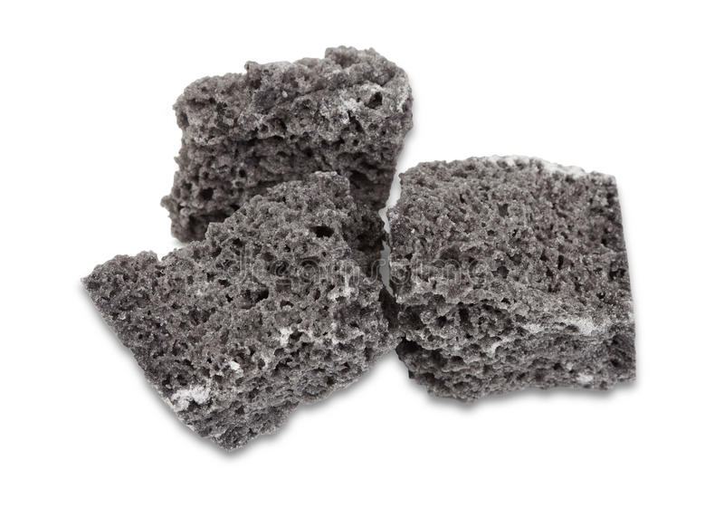
The legend says that “ La Befana” goes in every house where children live the night preceding the Epiphany (January 6th) . The last ones hang on a sock not far from the fireplace or not far from the window. For those having been good and kind during the year, Befana puts in their sock caramels or some chocolates, on the other hand, for those who were not kind it fills the socks of coal (In reality it is edible black sugar or licorice, which looks like coal).
La Befana appartient aux figures folkloriques, pourvue de dons, liés à la fête de la nativité. La légende dit que la Befana passe dans chaque maison où vivent des enfants la nuit précédant l'Épiphanie (le 6 janvier).Ces derniers accrochent une chaussette non loin de la cheminée ou de la fenêtre. Pour ceux ayant été bons et gentils au long de l'année, la Befana dépose dans leur chaussette des caramels ou des chocolats, en revanche, pour ceux qui n'ont pas été gentils elle remplit les chaussettes de charbon (En réalité il s'agit aujourd'hui de sucre noir comestible ou de la réglisse qui ressemble au charbon).

Slide 8
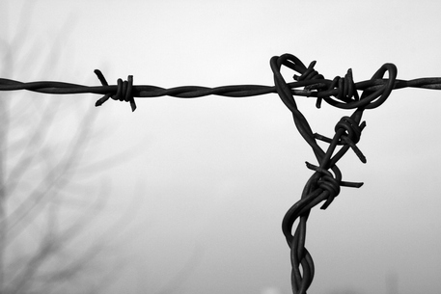
ON 27th January
International Holocaust Remembrance Day

Slide 9
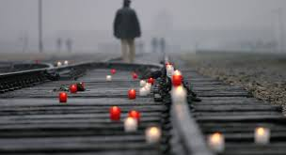
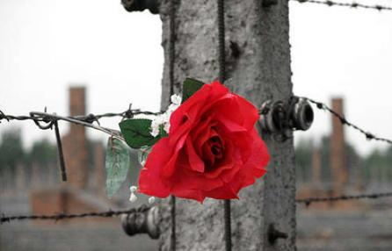
International Holocaust Remembrance Day commemorates the tragedy of the Holocaust that occurred during the Second World War. It commemorates the genocide that resulted in the death of an estimated 6 million Jewish people, 5 million Slavs, 3 million ethnic Poles, 200,000 Romani people, 250,000 mentally and physically disabled people, and 9,000 homosexual men by the Nazi regime and its collaborators. It was designated by the United Nations General Assembly resolution 60/7 on 1 November 2005 during the 42nd plenary session. The resolution came after a special session was held earlier that year on 24 January 2005 during which the United Nations General Assembly marked the 60th anniversary of the liberation of the Nazi concentration camps and the end of the Holocaust.

Slide 10
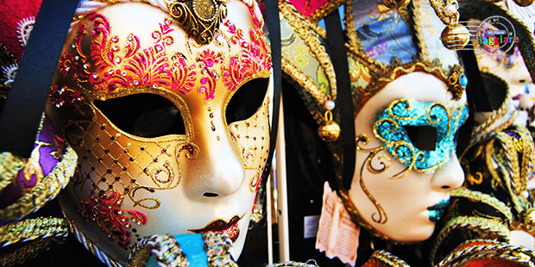
February
Carnival

Slide 11
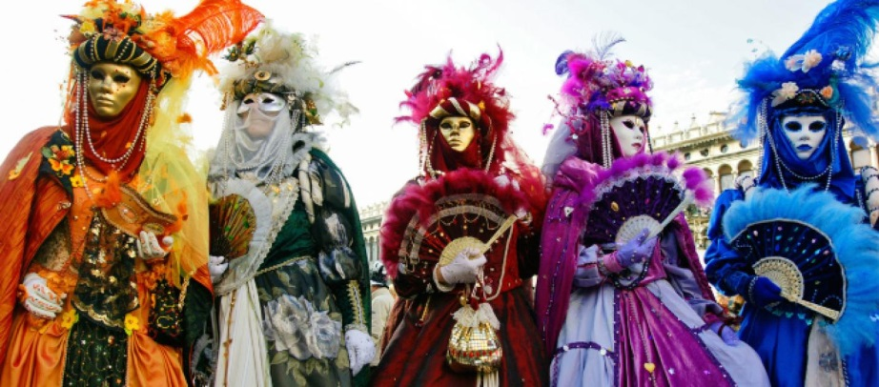
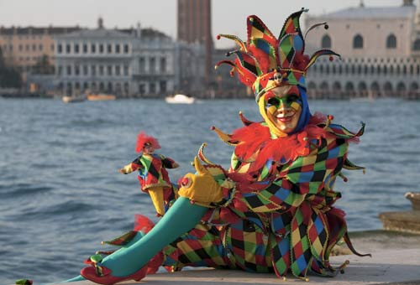
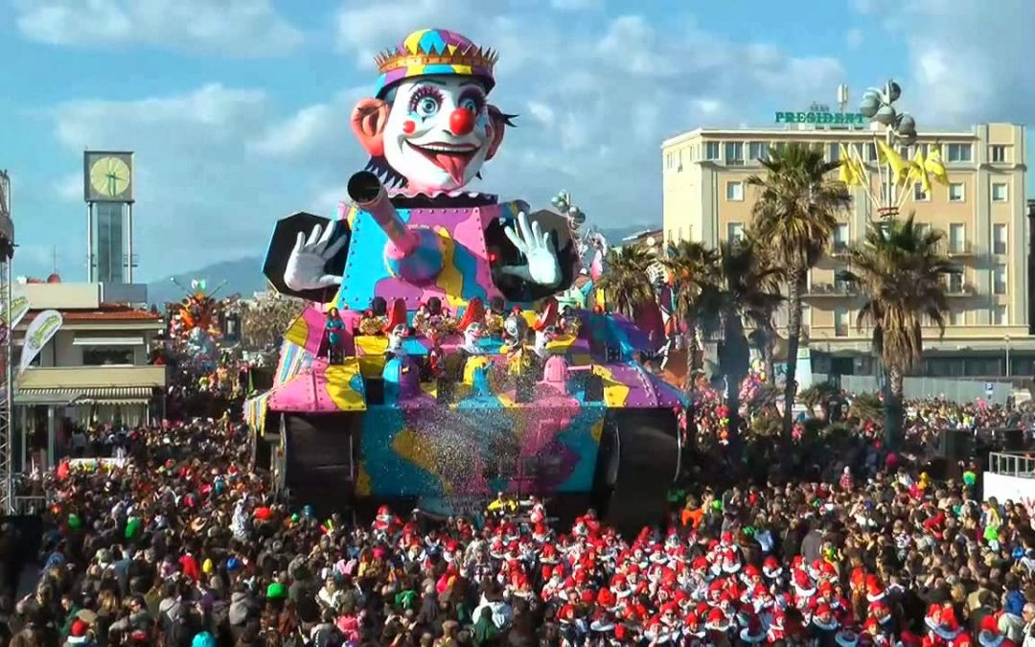
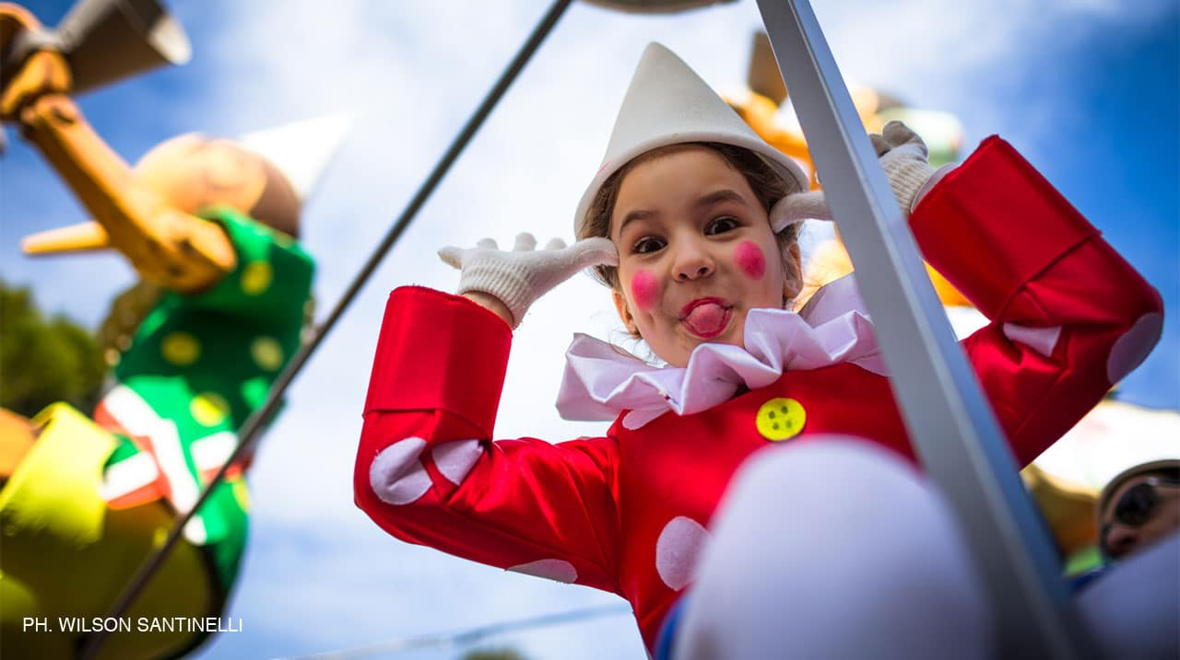
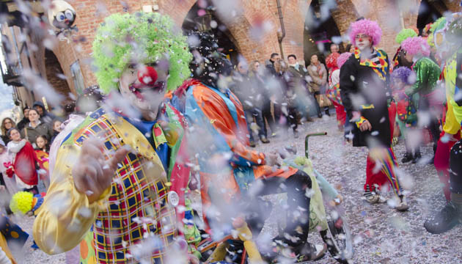
February in Italy means that every place on the Peninsula is invaded with masks, confetti, colours and lights that create a very exciting and unique atmosphere: it’s Carnival! It is a party with ancient roots, and today has become a folkloristic rite in which traditions and fun work together to bring enormous life to this unique celebration.
The most famous carnivals of Italy are those held in Venice, Viareggio, Ivrea, Cento, Satriano, and Acireale.

Slide 12
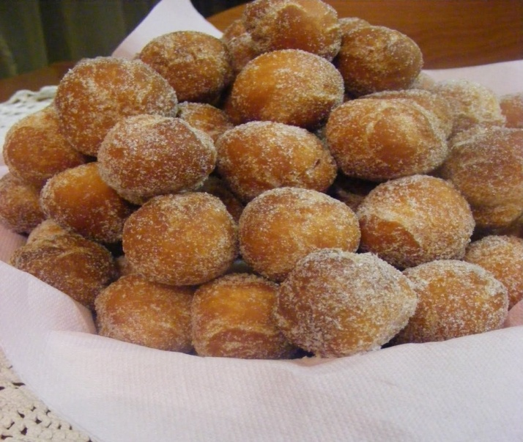
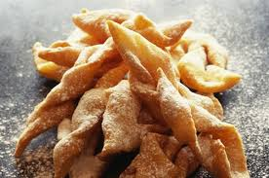
Nowadays, many traditions have vanished or changed, but fried pastries are still common in Fat Tuesday cookery. Spoonfuls of dough fried in oil take the shape of small balls in Frittelle or Castagnole.
However, the most famous carnival fritters are ribbons of sweet pasta fried and covered with sugar or honey. These fritters are familiar all over Italy, where they assume many different names—including Frappe, Frappole, Sfrappole, Flappe in central Italy, Cenci (“tatters”) or Donzelli (“young ladies”) in Tuscany, Crostoli (“crusts”) or Galani in Veneto, Lattughe(“lettuce”) in Romagna, Nastri delle Suore (“ribbons of the nuns”) in Emilia, Bugie (“lies”) in Piemonte, and Gigi in Sicily.
Is there another dish with so many names?

Slide 13
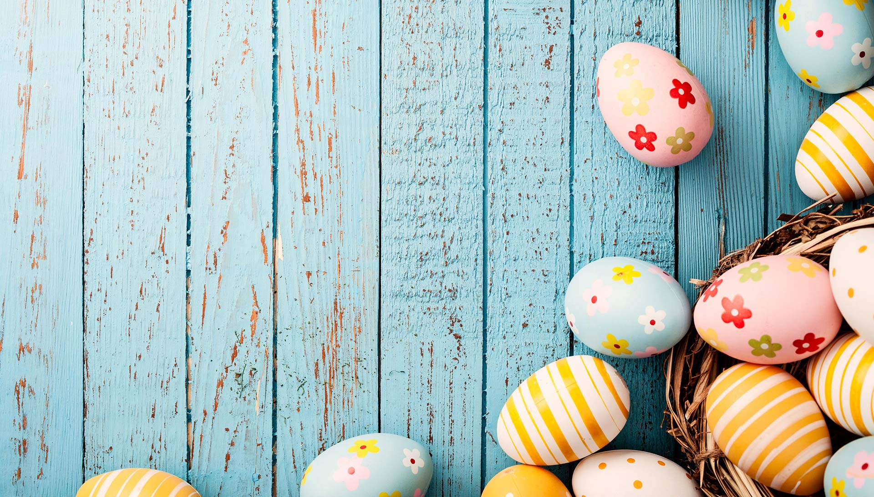
EASTER
And
EASTER MONDAY

Slide 14
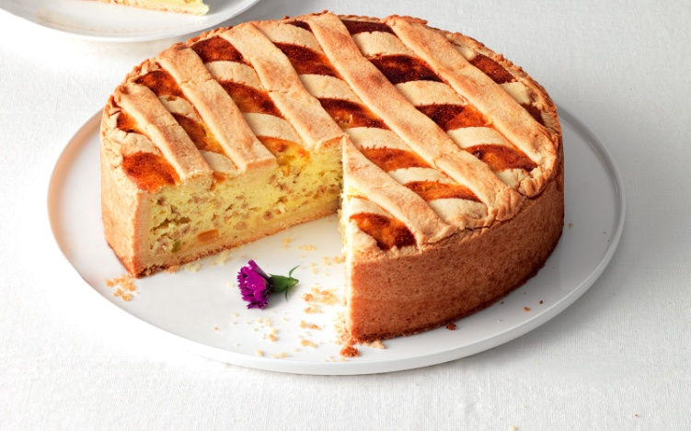
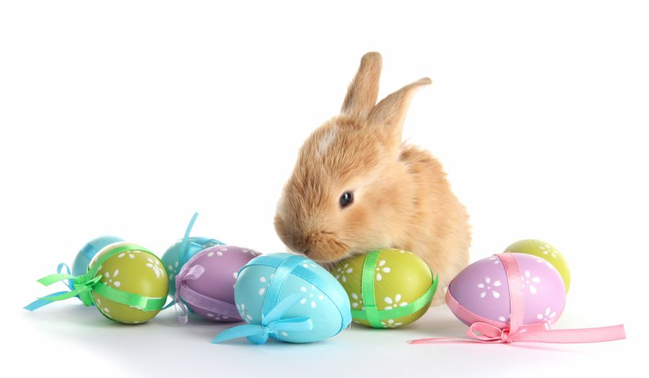
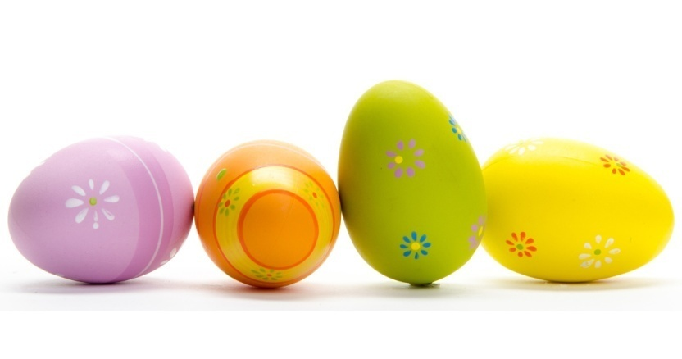
Easter, or Pasqua in Italian, is a festive holiday throughout Italy.
Religious parades and celebrations are held in many towns and cities nationwide. A statue of Jesus or his mother Mary is carried in street processions that involve large crowds of people. Easter meals vary, but include eggs, Easter pie, and lamb.
Eggs in Italian Easter dishes symbolize fertility, renewal and life. The date of Easter is fixed to the first Sunday after the first full moon which follows on March 21st
“Pastiera” is a traditional cake at Easter

Slide 15
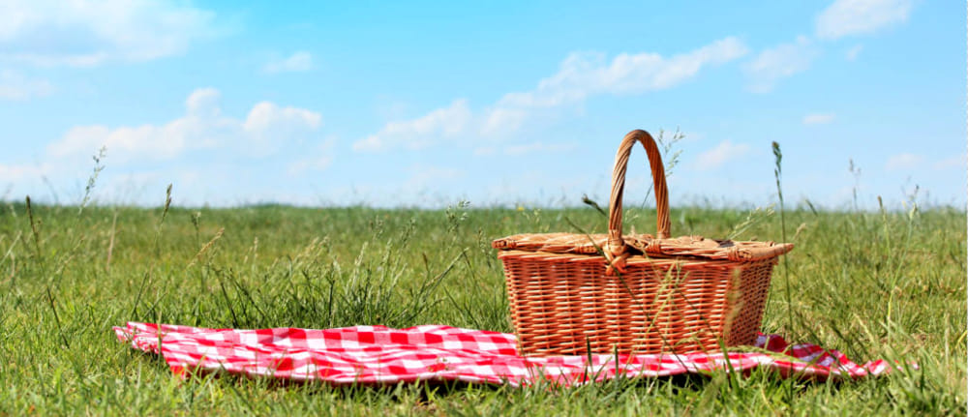
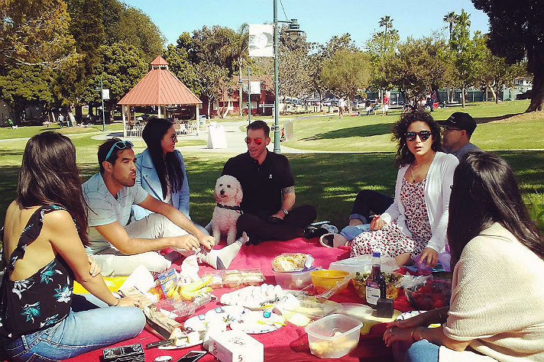
Easter Monday is the day after Easter Day.
In Italy, the tradition imposes to make excursions outside the city.

Slide 16
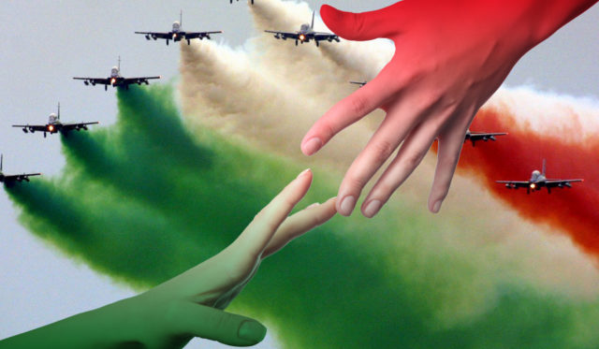
April 25th
Liberation Day

Slide 17
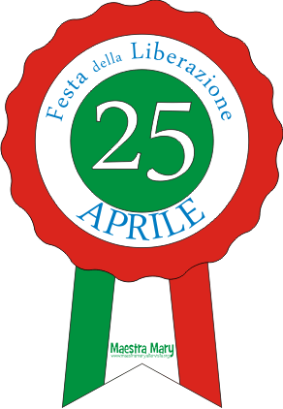
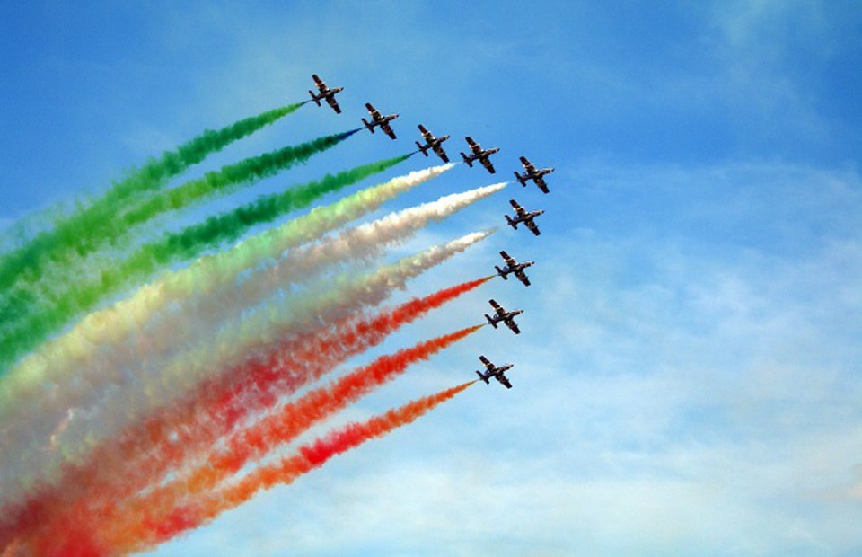
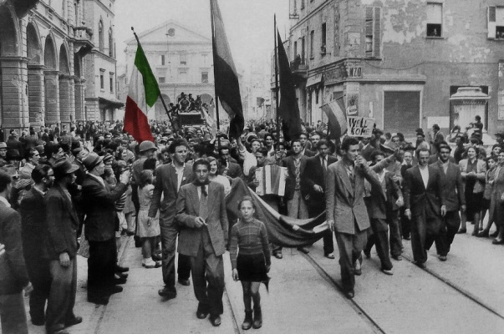
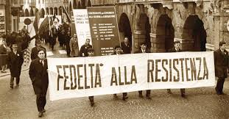
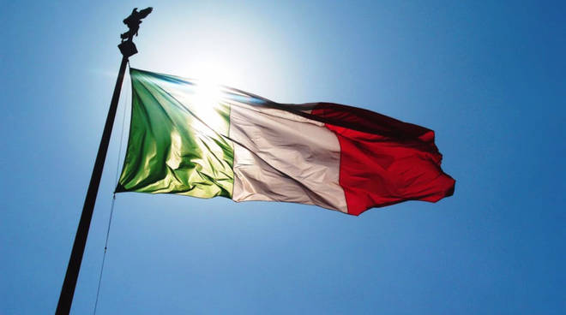
The Anniversary of the Liberation of Italy, also known under the name of the Liberation, Birthday(Anniversary) of the Resistance or more simply 25th-April, is the holiday, celebrated every April 25th in Italy, of remembrance of the end of the Second World War, and the end of the Nazi occupation of the country.

Slide 18
MAY 1ST LABOUR DAY

Slide 19
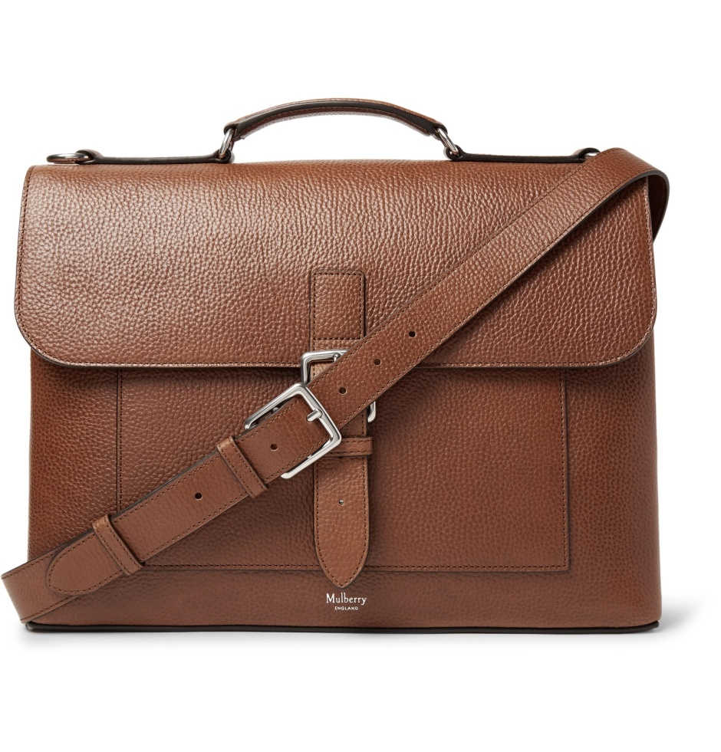
Labour Day, also known as May Day or Festa dei Lavoratori, is a public, nationwide holiday in Italy celebrating the working class on the first of May. Known as the day of the worker, this holiday allows public services such as schools and banks to close while the citizens of Italy organize festivals, parades, and spring rituals celebrating workers' rights and freedoms.

Slide 20
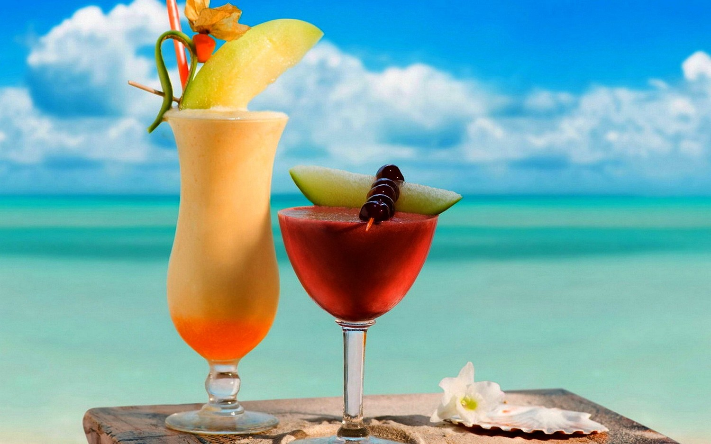
August 15th
Ferragosto

Slide 21
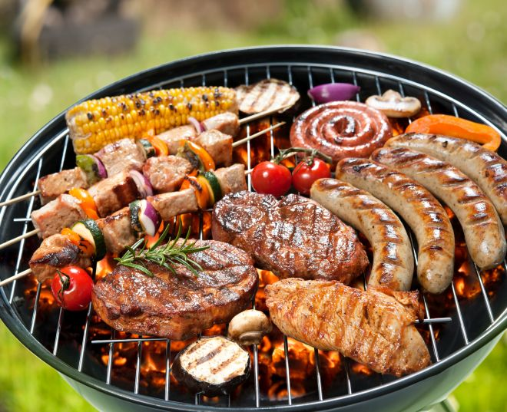
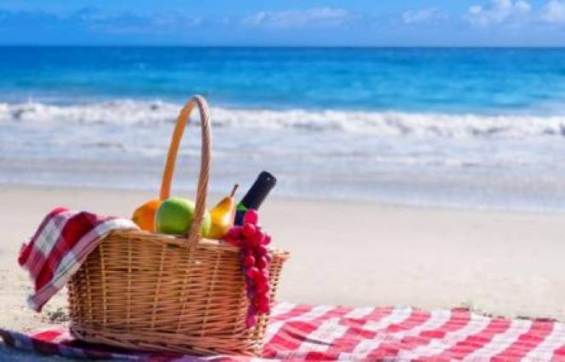
The popular tradition of taking a trip during Ferragosto arose under the Fascist regime. In the second half of the 1920s, during the mid-August period, the regime organised hundreds of popular trips through the Fascist leisure and recreational organisations of various corporations, and via the setting up of the "People's Trains of Ferragosto", which were available at discounted prices.^{[5]}
The initiative gave the opportunity to less well-off social classes to visit Italian cities or to reach seaside and mountain resorts. The offer was limited to 13, 14 and 15 August, and comprised two options: the "One-Day Trip", within a radius of 50-100 km, and the "Three-Day Trip" within a radius of about 100–200 km.
During the picnics, we usually eat roasted meat

Slide 22
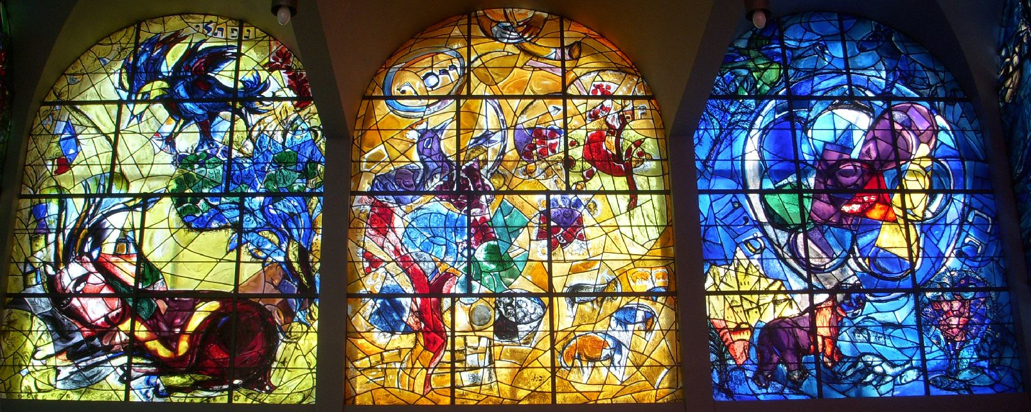
All Saints' Day

Slide 23
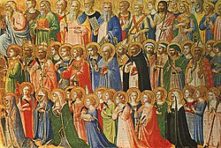
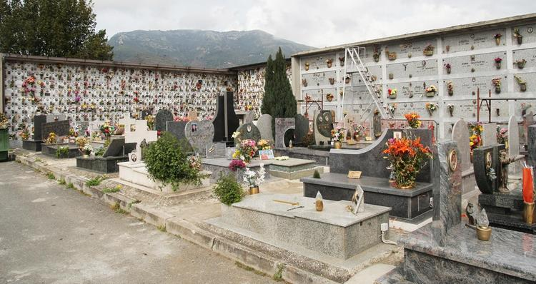
All Saints’ Day, also known as Festa di Tutti i Santi, is both a religious and public holiday in Italy on November 1st. It collectively celebrates all of the Catholic saints.
Tutti i Santi is a day when people visit family and friends and exchange gifts to one another. If Italians have the same name as a saint, it is a special day for them too.

Slide 24
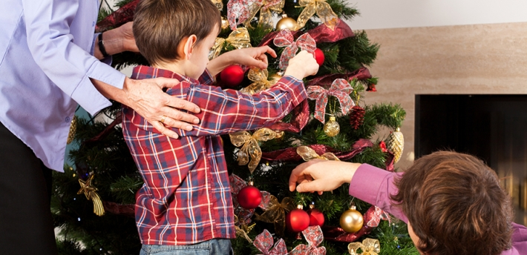
DECEMBER 8TH
Immaculate Conception

Slide 25
Immaculate Conception (L'Immacolata Concezione) is an Italian public holiday celebrated annually on December 8th. The day commemorates Mary, the mother of Jesus, who was graced by God to lead a life “free of sin” according to Catholic belief.
Many Italians go to Mass to honour Mary, who is immaculate, or “free from sin”. One of the highlights is a celebration led by the Catholic Pope in Rome, who kneels in prayer and lays a floral wreath on the statue of the Madonna at Piazza Mignanelli. In some places there is street entertainment by jugglers and street clowns for the public.

Slide 26
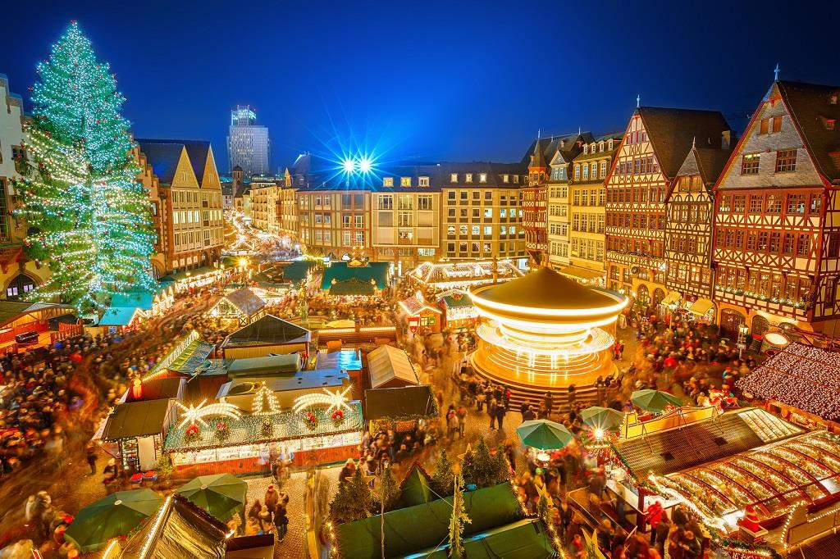
December 25th CHRISTMAS

Slide 27
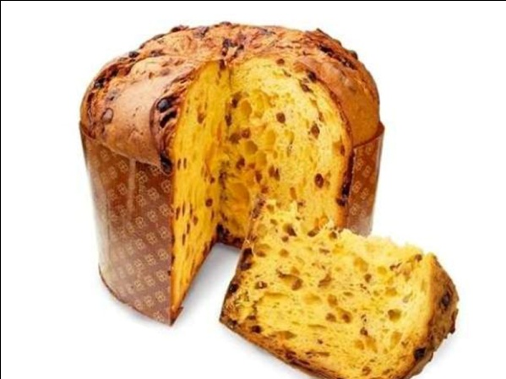
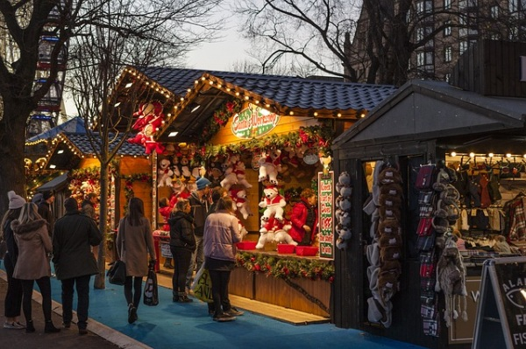
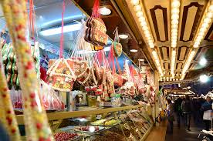
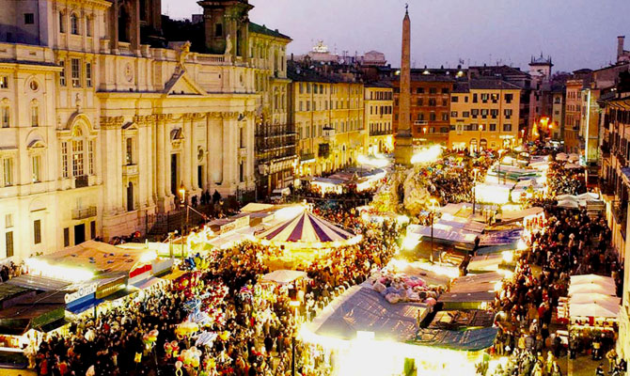
Christmas is a major holiday in Italy… which means Italians celebrate lots of great, unique Christmas traditions! Across Italy, Natale tends to be a family-centric holiday, a time to stay at home (and eat!) with loved ones. But customs also vary from city to city, from exactly which dishes are served, to when to open presents, making every region an interesting place to enjoy the holidays.
Christmas Day dinner is the most important Christmas family tradition in Italy. While Christmas Eve’s supper is a meatless meal, on Christmas Day it is allowed to eat meat. Usually people eat cappone (capon), tacchino (turkey), mixed roast or roast beef. Panettone is served as dessert or as breakfast. Another famous Christmas bread is Pandoro which originated from Verona. Torrone (nougat), with honey or chocolate almonds or pistachios, is one of the most typical Christmas sweets.
“Panettone” is a part of the Christmas Italian tradition.

Slide 28
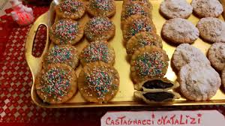
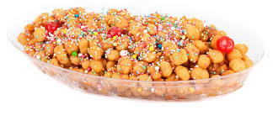
Typical Christmas sweets in Campania are calzoncelli and struffoli.
Recipes:
Calzoncelli are made of shortcrust pastry filled with chocolate, chestnuts and coffee. You have to mix all the ingredients and blend until you’ve got a smooth paste. Then you roll out the shortcrust pastry as thin as you can, wrap it around the filling and cut it into small pieces.
Calzoncelli can be baked or fried. You can keep them for weeks in a tin box
or an airtight container.
Struffoli have the shape of small balls. They are crunchy pastry balls, deep-fried, then rolled in honey and at the end scattered with pine nuts and coloured sugar sprinkles.

Slide 29
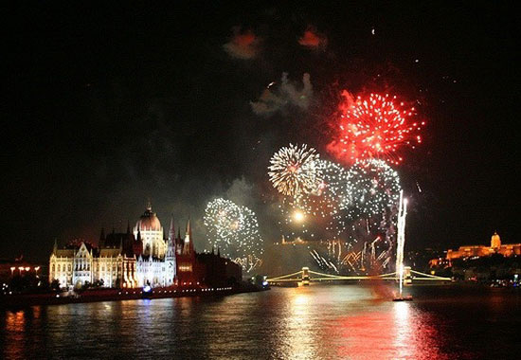
December 26th
Santo Stefano

Slide 30
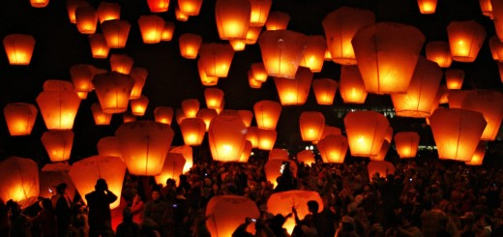
St Stephen’s Day (Il giorno di Santo Stefano) is celebrated as a public holiday across Italy on December 26. It is the day after Christmas Day (Natale).
St Stephen is believed to be the first Christian martyr. He was stoned to death sometime around the year 33 CE. St Stephen’s day was made a public holiday in Italy in 1947.

